Slide 1

INSTITUTE : UIE
DEPARTMENT : CSE
Bachelor of Engineering (Computer Science & Engineering)
Mobile Application Development(20CST-355)
TOPIC OF PRESENTATION:
Activity states and lifecycle, Interaction among activities
Prepared by:
Parveen Kumar Saini(E13339)
DISCOVER . LEARN . EMPOWER

Slide 2
Activities

Slide 3
Contents
Activities
Defining an activity
Starting a new activity with an intent
Passing data between activities with extras
Navigating between activities

Slide 4
Activities
(high-level view)

Slide 5
What is an Activity?
An Activity is an application component
Represents one window, one hierarchy of views
Typically fills the screen, but can be embedded in other activity or a appear as floating window
Java class, typically one activity in one file

Slide 6
What does an Activity do?
Represents an activity, such as ordering groceries, sending email, or getting directions
Handles user interactions, such as button clicks, text entry, or login verification
Can start other activities in the same or other apps
Has a life cycle—is created, started, runs, is paused, resumed, stopped, and destroyed

Slide 7
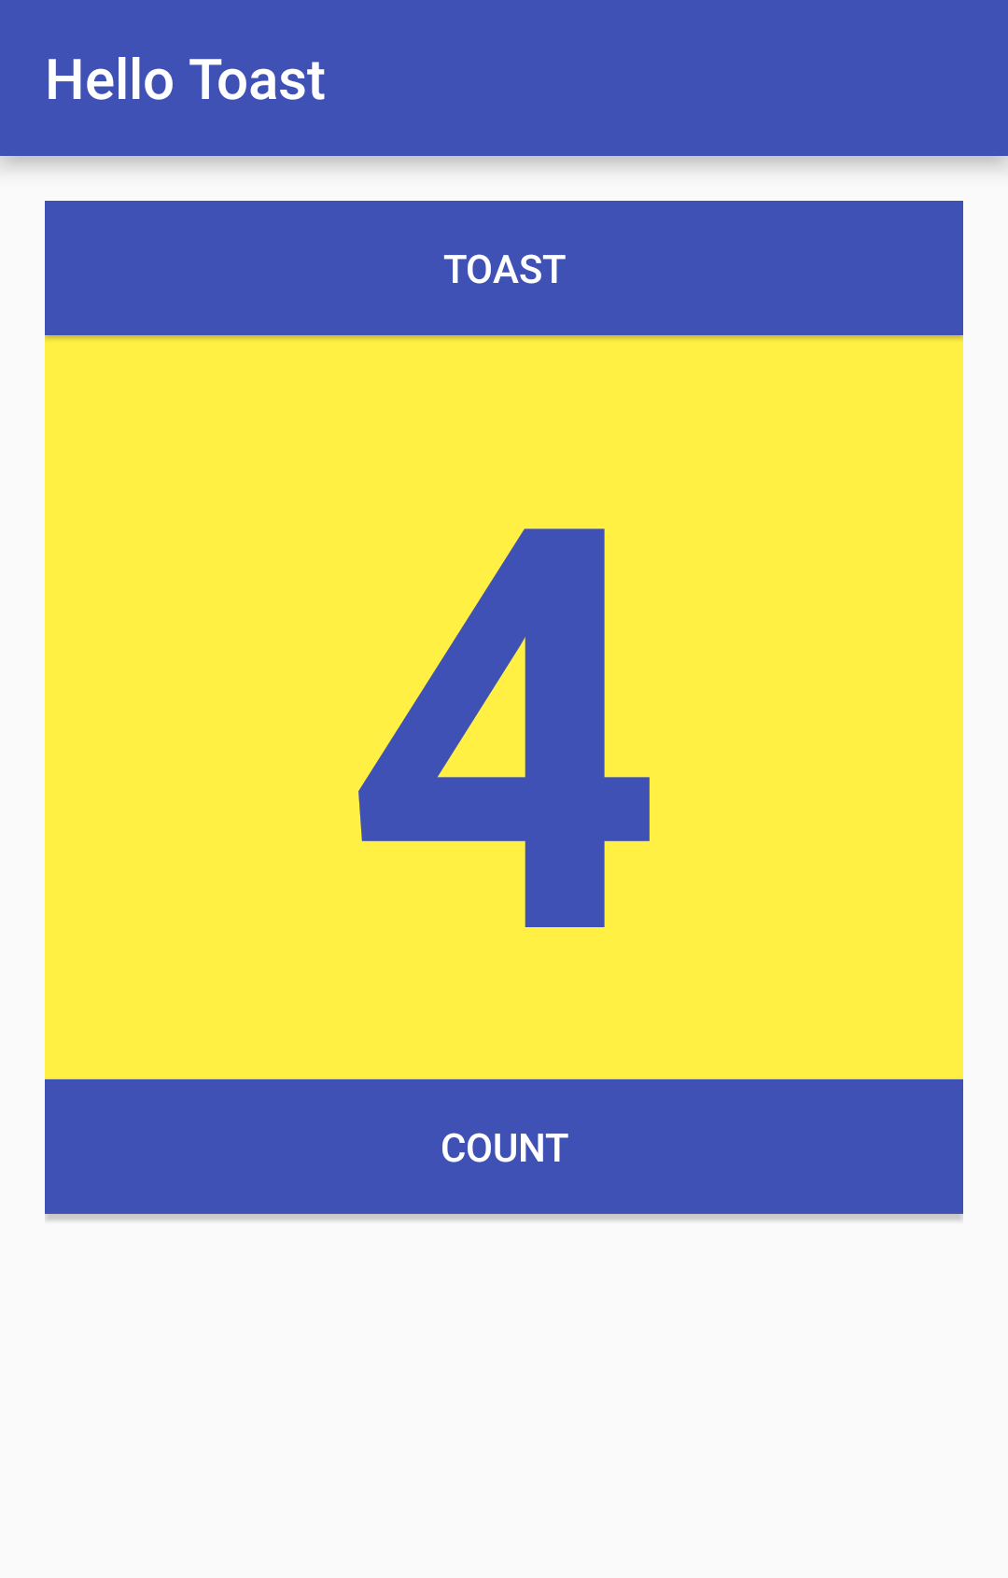
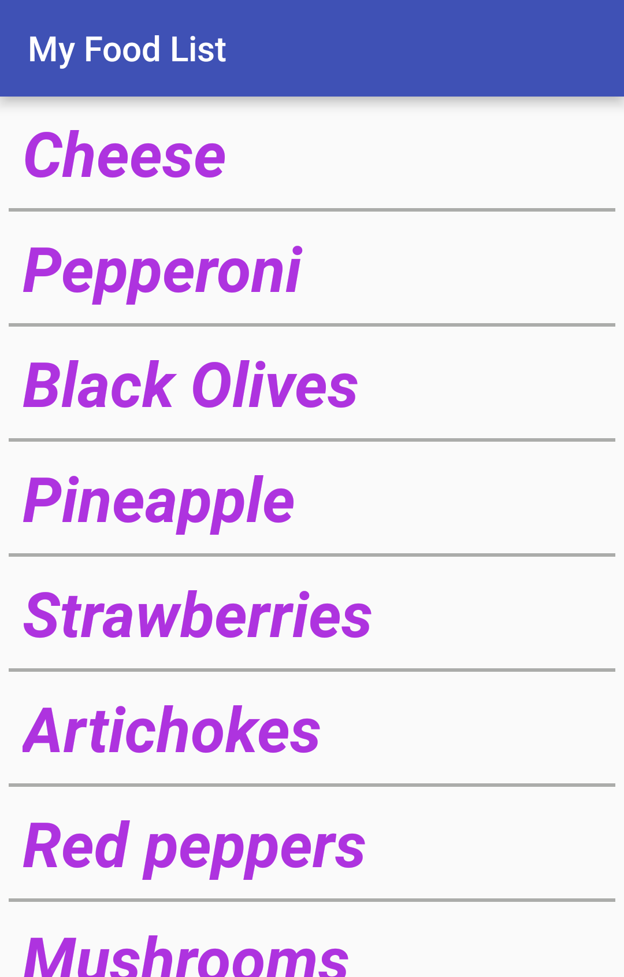
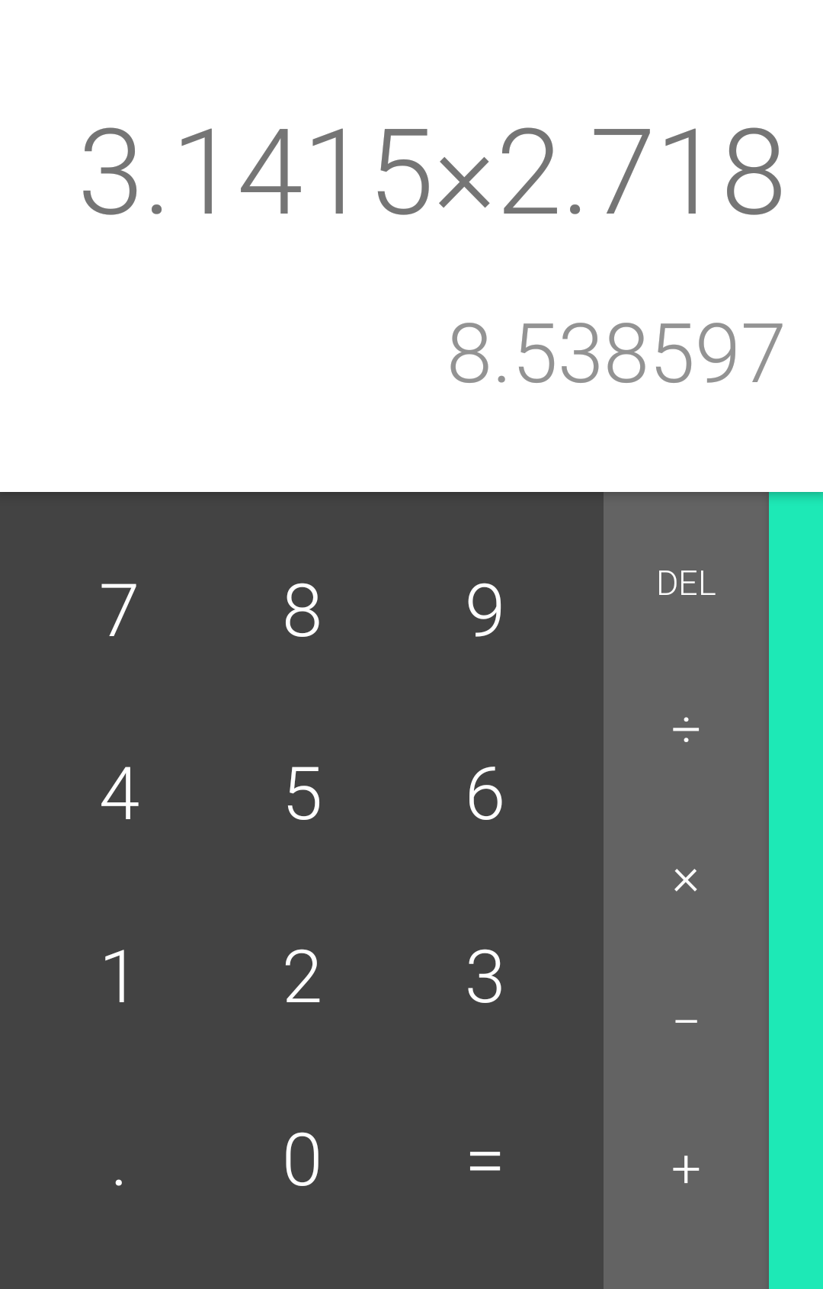
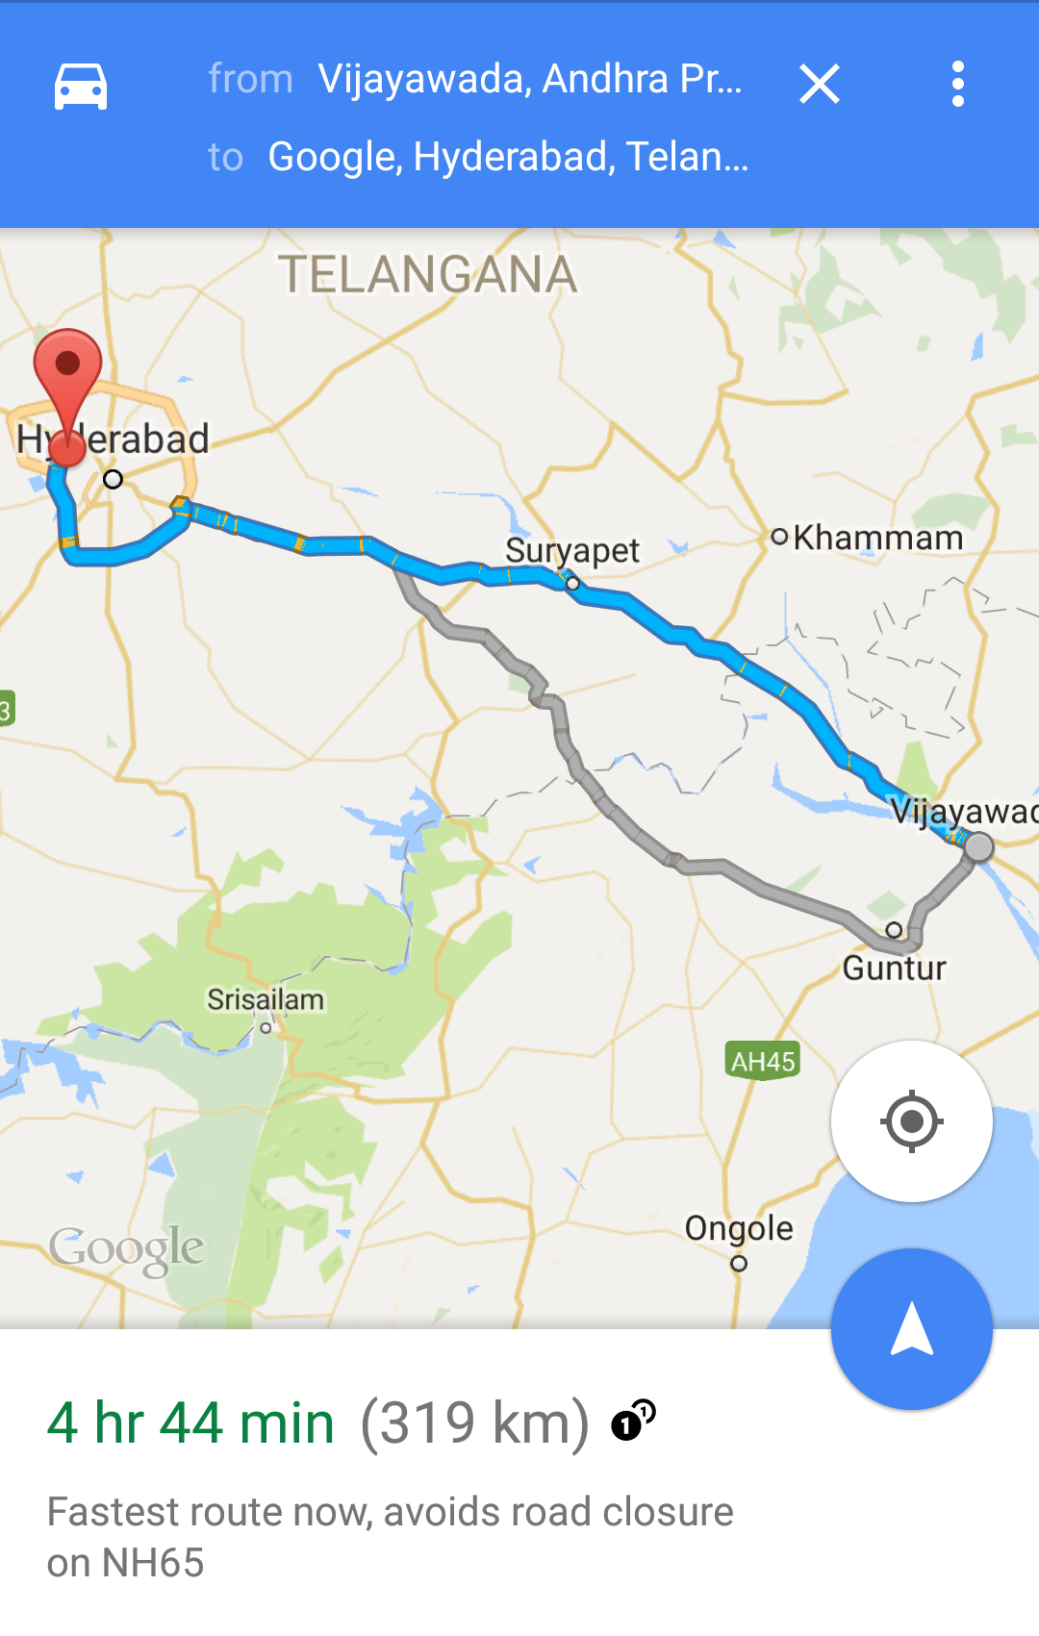
Examples of activities

Slide 8
Apps and activities
Activities are loosely tied together to make up an app
First activity user sees is typically called "main activity"
Activities can be organized in parent-child relationships in the Android manifest to aid navigation

Slide 9
Layouts and Activities
An activity typically has a UI layout
Layout is usually defined in one or more XML files
Activity "inflates" layout as part of being created

Slide 10
Intents

Slide 11
What is an intent?
An intent is a description of an operation to be performed.
An Intent is an object used to request an action from another app component via the Android system.
Originator
App component
Intent
Action
Android System

Slide 12
What can intents do?
Start activities
A button click starts a new activity for text entry
Clicking Share opens an app that allows you to post a photo
Start services
Initiate downloading a file in the background
Deliver broadcasts
The system informs everybody that the phone is now charging

Slide 13
Explicit and implicit intents
Explicit Intent
Starts a specific activity
Request tea with milk delivered by Nikita
Main activity starts the ViewShoppingCart activity
Implicit Intent
Asks system to find an activity that can handle this request
Find an open store that sells green tea
Clicking Share opens a chooser with a list of apps

Slide 14
How Activities Run
All activities are managed by the Android runtime
Started by an "intent", a message to the Android runtime to run an activity
User clicks launcher icon
MainActivity What do you want to do?
FoodListActivity Choose food items...Next
OrderActivity Place order
Intent: Start app
Start main activity
Intent: Shop
Start choose food activity
Intent: order
Start finish order activity
Android System
Android System
Android System

Slide 15
Sending and Receiving Data

Slide 16
Two types of sending data with intents
Data—one piece of information whose data location can be represented by an URI
Extras—one or more pieces of information as a collection of key-value pairs in a Bundle

Slide 17
Sending and retrieving data
In the first (sending) activity:
Create the Intent object
Put data or extras into that intent
Start the new activity with startActivity()
In the second (receiving) activity,:
Get the intent object the activity was started with
Retrieve the data or extras from the Intent object

Slide 18

Activity stack
When a new activity is started, the previous activity is stopped and pushed on the activity back stack
Last-in-first-out-stack—when the current activity ends, or the user presses the Back button, it is popped from the stack and the previous activity resumes

Slide 19
Activity Stack
After viewing shopping cart, user decides to add more items, then places order.
OrderActivity Place order
CartActivity View shopping cart
CartActivity View shopping cart
OrderActivity Place order
CartActivity View shopping cart
CartActivity View shopping cart
FoodListActivity Choose food items
FoodListActivity Choose food items
FoodListActivity Choose food items
FoodListActivity Choose food items
MainActivity What do you want to do?
MainActivity What do you want to do?
MainActivity What do you want to do?
MainActivity What do you want to do?

Slide 20

Two forms of navigation
Temporal or back navigation
provided by the device's back button
controlled by the Android system's back stack
Ancestral or up navigation
provided by the app's action bar
controlled by defining parent-child relationships between activities in the Android manifest
Notes:
Up is left

Slide 21
Back navigation
Back stack preserves history of recently viewed screens
Back stack contains all the activities that have been launched by the user in reverse order for the current task
Each task has its own back stack
Switching between tasks activates that task's back stack
Launching an activity from the home screen starts a new task
Navigate between tasks with the overview or recent tasks screen
Notes:
Up is left

Slide 22
Up navigation
Goes to parent of current activity
Define an activity's parent in Android manifest
Set parentActivityName
<activity
android:name=".ShowDinnerActivity"
android:parentActivityName=".MainActivity" >
</activity>

Slide 23
Activity Lifecycle and Managing State

Slide 24
Contents
Activity lifecycle
Activity lifecycle callbacks
Activity instance state
Saving and restoring activity state

Slide 25
Activity Lifecycle

Slide 26
What is the Activity Lifecycle?
The set of states an activity can be in during its lifetime, from when it is created until it is destroyed
More formally:
A directed graph of all the states an activity can be in, and the callbacks associated with transitioning from each state to the next one

Slide 27
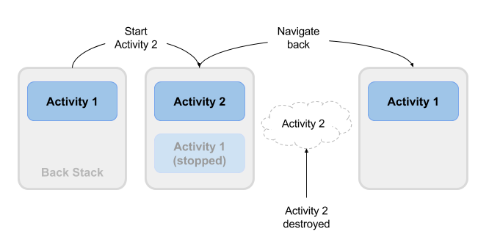
What is the Activity Lifecycle?

Slide 28
Activity states and app visibility
Created (not visible yet)
Started (visible)
Resume (visible)
Paused(partially invisible)
Stopped (hidden)
Destroyed (gone from memory)
State changes are triggered by user action, configuration changes such as device rotation, or system action

Slide 29
Callbacks and when they are called
onCreate(Bundle savedInstanceState)—static initialization
onStart()—when activity (screen) is becoming visible
onRestart()—called if activity was stopped (calls onStart())
onResume()—start to interact with user
onPause()—about to resume PREVIOUS activity
onStop()—no longer visible, but still exists and all state info preserved
onDestroy()—final call before Android system destroys activity

Slide 30
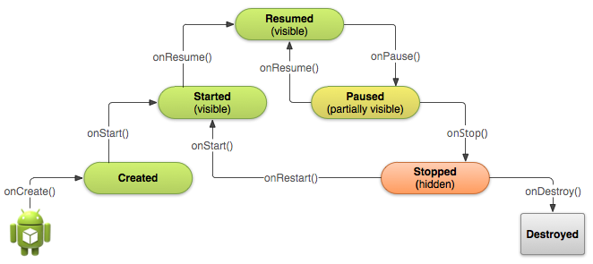
Activity states and callbacks graph

Slide 31
Implementing and overriding callbacks
Only onCreate() is required
Override the other callbacks to change default behavior

Slide 32
onCreate() –> Created
Called when the activity is first created, for example when user taps launcher icon
Does all static setup: create views, bind data to lists, ...
Only called once during an activity's lifetime
Takes a Bundle with activity's previously frozen state, if there was one
Created state is always followed by onStart()

Slide 33
onStart() –> Started
Called when the activity is becoming visible to user
Can be called more than once during lifecycle
Followed by onResume() if the activity comes to the foreground, or onStop() if it becomes hidden

Slide 34
onRestart() –> Started
Called after activity has been stopped, immediately before it is started again
Transient state
Always followed by onStart()

Slide 35
onResume() –> Resumed/Running
Called when activity will start interacting with user
Activity has moved to top of the activity stack
Starts accepting user input
Running state
Always followed by onPause()

Slide 36
onPause() –> Paused
Called when system is about to resume a previous activity
The activity is partly visible but user is leaving the activity
Typically used to commit unsaved changes to persistent data, stop animations and anything that consumes resources
Implementations must be fast because the next activity is not resumed until this method returns
Followed by either onResume() if the activity returns back to the front, or onStop() if it becomes invisible to the user

Slide 37
onStop() –> Stopped
Called when the activity is no longer visible to the user
New activity is being started, an existing one is brought in front of this one, or this one is being destroyed
Operations that were too heavy-weight for onPause
Followed by either onRestart() if this activity is coming back to interact with the user, or onDestroy() if this activity is going away

Slide 38
onDestroy() –> Destroyed
Final call before activity is destroyed
User navigates back to previous activity, or configuration changes
Activity is finishing or system is destroying it to save space
Call isFinishing() method to check
System may destroy activity without calling this, so use onPause() or onStop() to save data or state

Slide 39
Activity Instance State

Slide 40
When does config change?
Configuration changes invalidate the current layout or other resources in your activity when the user:
rotates the device
chooses different system language, so locale changes
enters multi-window mode (Android 7)

Slide 41
What happens on config change?
On configuration change, Android:
1. shuts down activity by calling:
2. then starts it over by calling:
onPause()
onStop()
onDestroy()
onCreate()
onStart()
onResume()

Slide 42
Activity instance state
State information is created while the activity is running, such as a counter, user text, animation progression
State is lost when device is rotated, language changes, back-button is pressed, or the system clears memory

Slide 43
Activity instance state
System only saves:
State of views with unique ID (android:id) such as text entered into EditText
Intent that started activity and data in its extras
You are responsible for saving other activity and user progress data

Slide 44
Saving instance state
Implement onSaveInstanceState() in your activity
called by Android runtime when there is a possibility the activity may be destroyed
saves data only for this instance of the activity during current session

Slide 45
Instance state and app restart
When you stop and restart a new app session, the activity instance states are lost and your activities will revert to their default appearance
If you need to save user data between app sessions, use shared preferences or a database.

Slide 46
THANK YOU
For queries
Email: parveen.e13339@cumail.in

